Slide 1
SS ZG653 : Software Architecture Assignment :1
Name: Satish Kumar Sharma
Email: 2022MT93327@wilp.bits-pilani.ac.in
ID Number: 2022MT93327

Slide 2
Table of Contents
Page Details | Page Number
Purpose of the system | 3 and 4
Key Requirements : Functional & Non-Functional | 5
Utility tree of Architecturally Significant Requirements (ASR) | 6 and 7
Tactics used to achieve the top 5 ASRs | 8
Software Architecture diagram – Context diagram | 9
Module decomposition | 10 and 11
Component & Connection diagram | 12
Deployment diagram | 13
Description of how the system works | 14 and 15
Key learnings | 16

Slide 3
Purpose of the system
Offer customers interest on deposits, helping to protect against money losing value against inflation.
Lending money to firms, customers and homebuyers.
Offering financial advice and related financial services, such as insurance
Instant access to cash (hole in the wall cash machines)
Bank lending is profitable for banks and can incur significant costs for the firm.
Offer customers to Open account (Saving and Current Account)
Offer customers to Deposits and Fund Transfer
Offer customers to Withdrawal Money
Keep money safe for customers

Slide 4
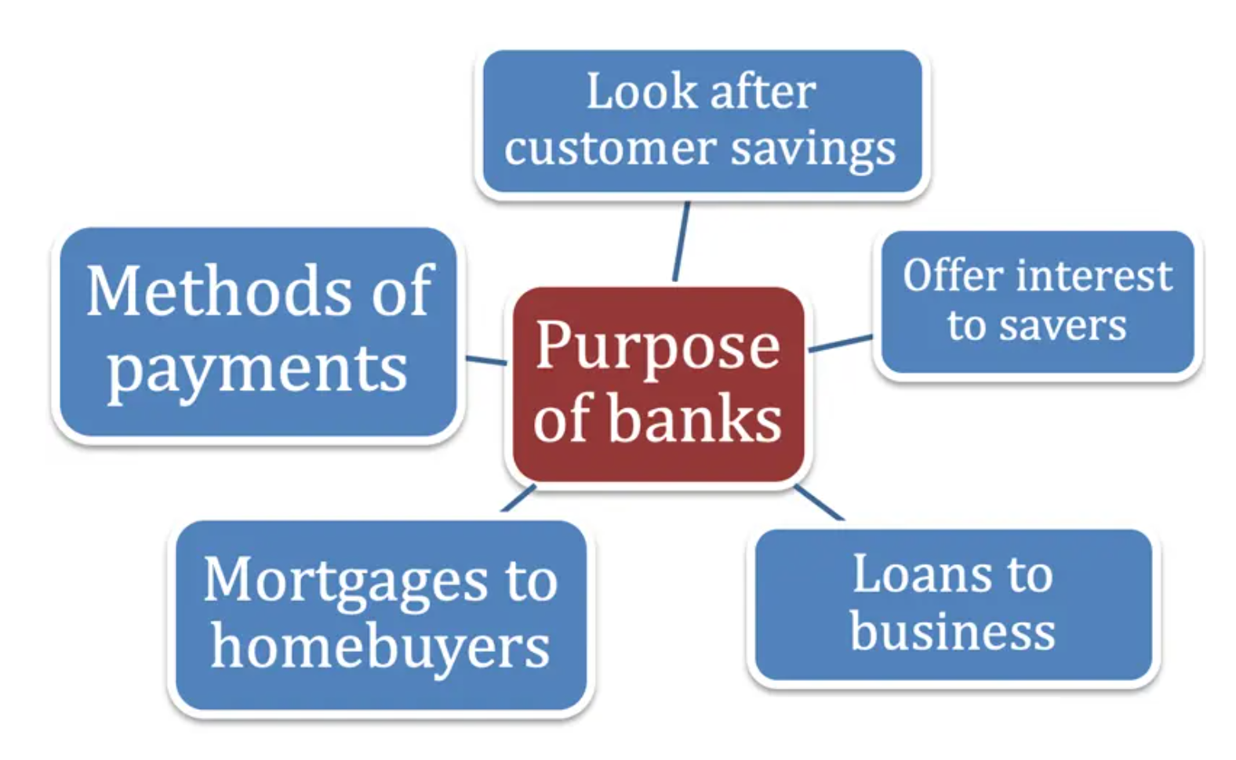
Purpose of the system Visual

Slide 5
Key Requirements : Functional & Non-Functional
Functional requirements | Non Functional requirements
Login Validation Get balance information Withdrawal of money Transfer Money Customer info Beneficiary Administrative Control Account Information View statements transaction Open Saving or Current Account | Performance Operation and Maintenance Backup Security Automatic & Elastic Scaling Reliability

Slide 6
Architecturally Significant Requirements (ASR)
The system must respond within 30 seconds.
The system must encrypt all network traffic.
The system should available 24/7 to Business.
New feature required to apply on existing system.
The System must be tested like Usability, Security, Scalability testing... etc.
The system must record every modification to customer records for audit purposes.
The Banking system must fund transfer and validated account holders with sufficient cleared funds.

Slide 7
Utility tree of Architecturally Significant Requirements (ASR)
Quality Attribute | Requirement | Question | Response | Impact | Measure
Performance | The system must respond within 30 seconds. | Is system response with in time? | Response<100ms | Medium | Yes
Security | The system must encrypt all network traffic. | Is system encrypt data? | Yes, all data encrypted. | High | Yes
Availability | The system should available 24/7. Business. | Is down time less than 99.999%? | Yes. | High | Yes
Modifiability | New feature required to apply on existing system. | Is new changes apply? | Yes, Easy to apply new changes | Low | No
Testability | The System must be tested like Usability, Security, Scalability testing..etc. | Is system follow all standard? | Yes, it’s tested with all standard. | High | Yes

Slide 8
Tactics used to achieve the top 5 ASRs
Quality Attribute | Tactics
Performance | Control resource demand | Limit event response | Increase resource Efficiency
 | Manages Resource | Increase resource | Schedule Resources
Security | Detect Attacks | Detect Intrusion | Verify Message Integrity
 | Resist and React to Attacks | Identify Actors, Revoke Access | Encrypt Data, Lock computer
Availability | Detect Faults | Monitor system | Self testing
 | Recover from faults | Preparation and Repair | Exception Handling
Modifiability | Reduce size of a Modules | Split Modules | Reduce coupling
Testability | Control and Observe System State | Sandbox, record | Playback and

Slide 9
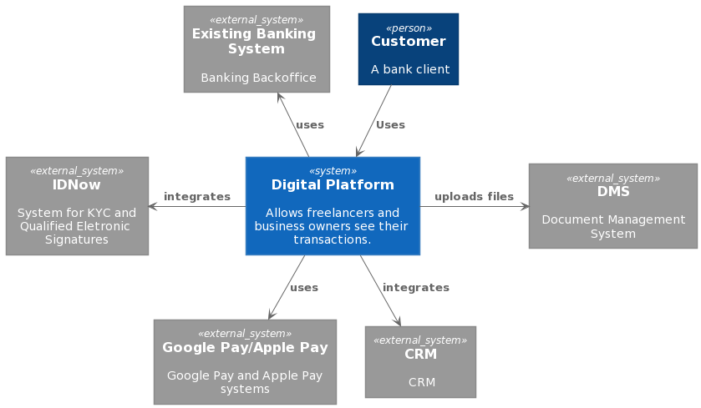
Software Architecture diagram – Context diagram

Slide 10
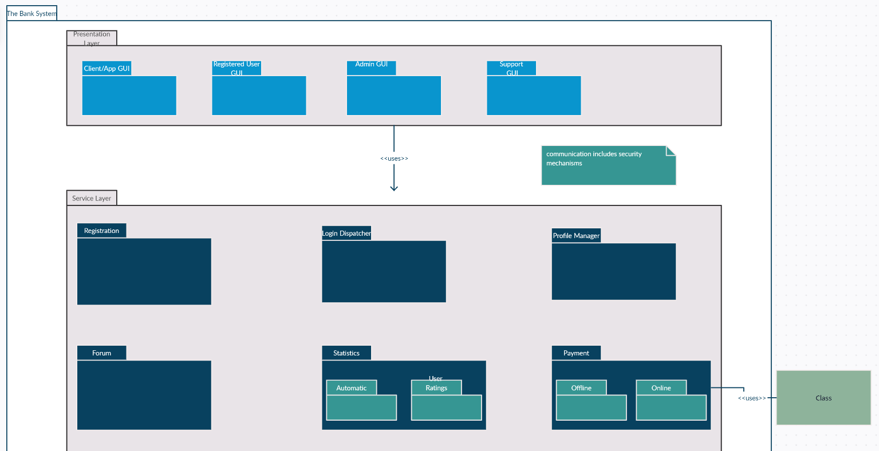
Software Architecture diagram –Module decomposition – Part 1

Slide 11
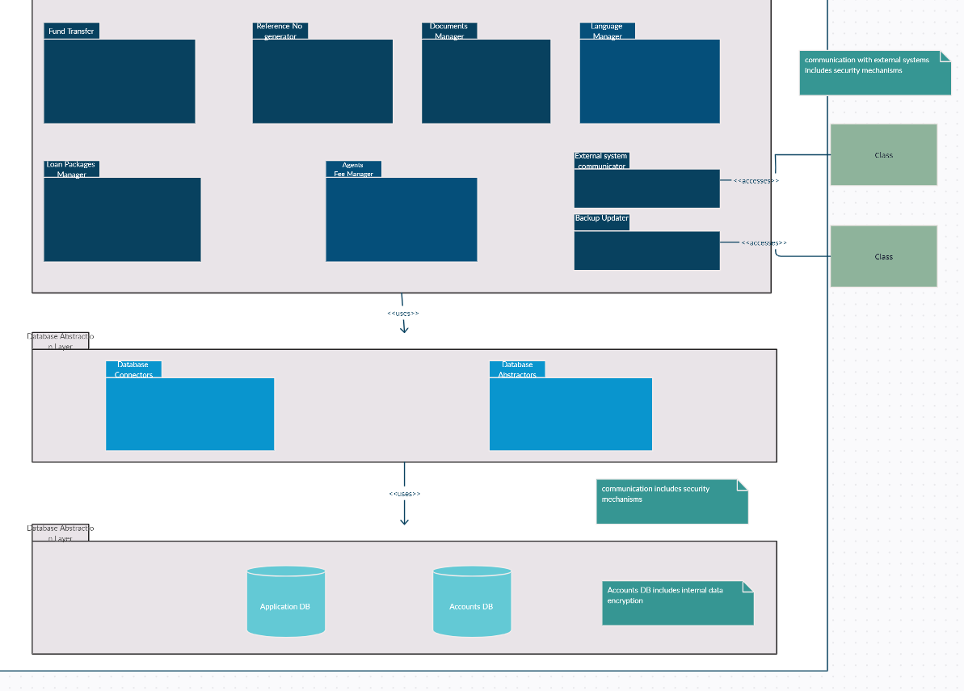
Part 2

Slide 12
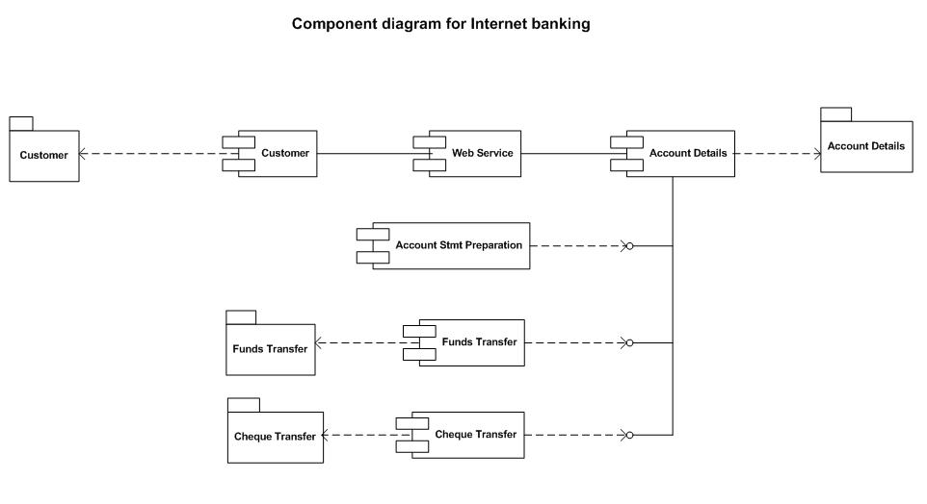
Software Architecture diagram – Component & Connection diagram

Slide 13
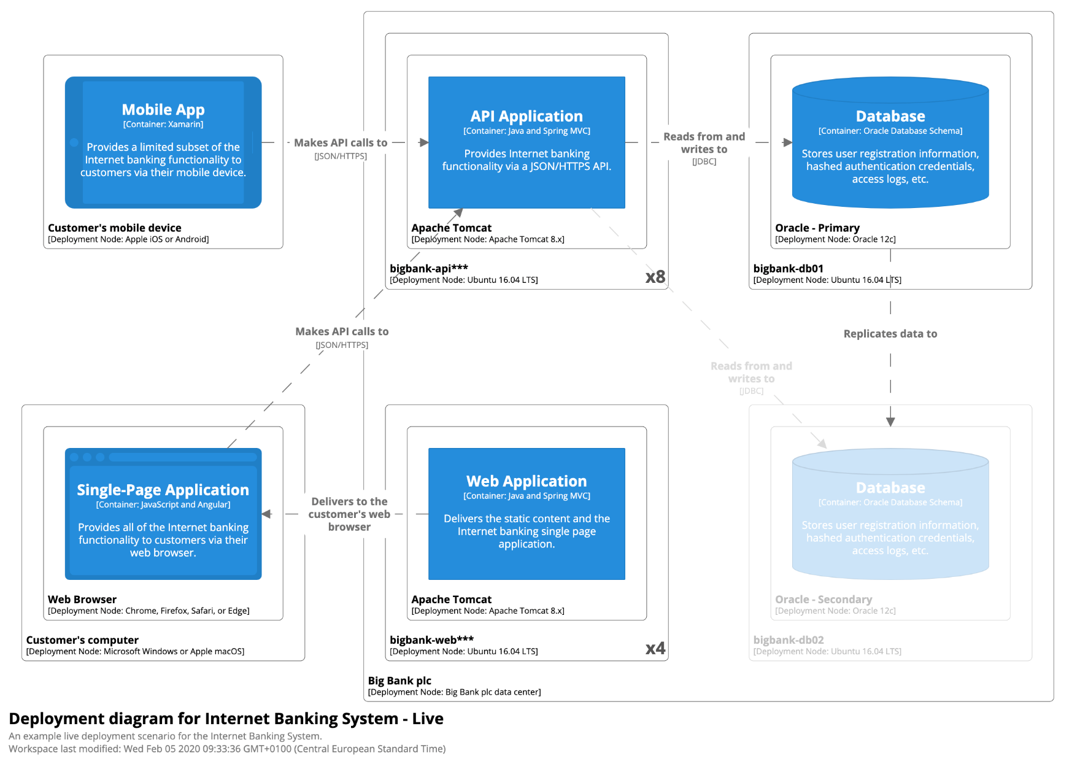
Software Architecture diagram-Deployment diagram

Slide 14
Description of how the system works
A bank is a financial institution which is involved in borrowing and lending money. Banks take customer deposits in return for paying customers an annual interest payment. The bank then uses the majority of these deposits to lend to other customers for a variety of loans. The difference between the two interest rates is effectively the profit margin for banks. Banks play an important role in the economy for offering a service for people wishing to save. Banks also play an important role in offering finance to businesses who wish to invest and expand. These loans and business investment are important for enabling economic growth.

Slide 15
Description of how the system works Diagram

Slide 16
Key learnings
Personal Learnings
Gather and find the goal of System.
Find Architecturally Significant Requirements (ASR)?
Prepare Utility Tree.
Create UML Component Diagram.
Create context and deployment diagram.
Learning to organization
Challenges in building and managing high scalable web and mobile applications system.

Slide 17
Thank You
Name: Satish Kumar Sharma
ID Number: 2022MT93327

